Slide 1
Lecture 8: Elliptic Curve Crypto
A (minimal) introduction

Slide 2
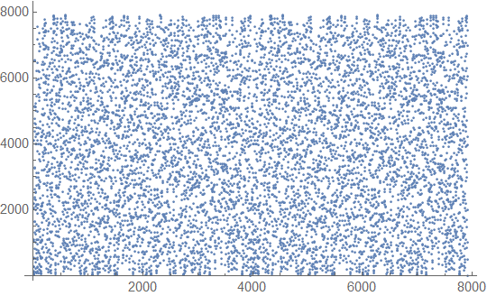
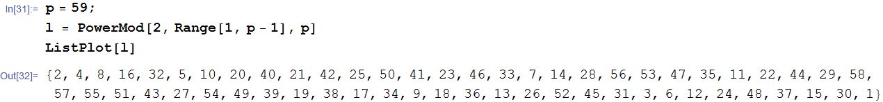
Why bothering with ECC?
Computational security = Hard problems
Easy in one way
Hard in the other way
Example: discrete logarithm
Z*(p), p>2 prime, group order q
x → g^{x} mod p easy
g^{x} → x mod p hard
Not restricted to Z*(p), can be any cyclic group Gp
2^x mod 7919

Slide 3
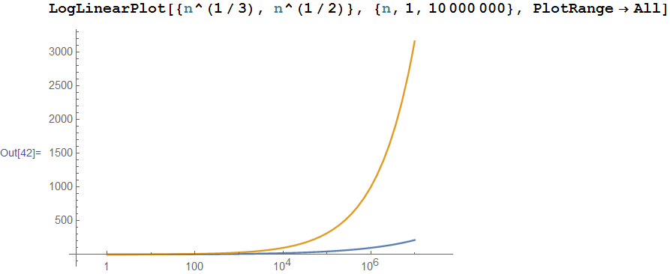
Why bothering with ECC?
Same problem (e.g. Dlog, factoring), different “hardness” in different groups!
Dlog in Z*(p): exp(O(n^{1/3}))
Dlog in EC: exp(O(n^{1/2}))
Dlog in (Z(p),+)): poly!
Symm key equiv modulus size
80 bits 1024 bits
128 bits 3072 bits
256 bits 15360 bits
Elliptic Curve
163 bits
283 bits
571 bits
EC scales well (so far) with increased security parameter!!
Obvious long term deployment choice (now clear why so many new EC ciphers in TLS)!

Slide 4
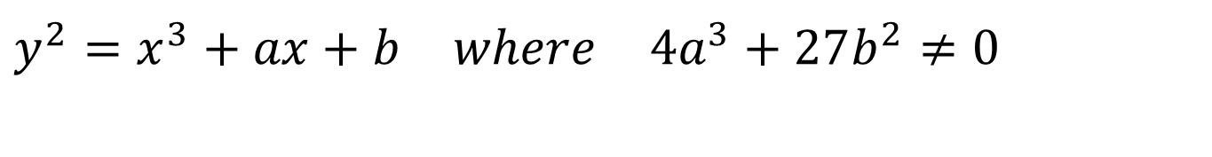
Elliptic curves
They are NOT ellipses!
They are special cubic curves
Named from elliptic integrals
General (Weierstrass) expression
$$y^{2}=x^{3}+ax+b where 4a^{3}+27b^{2}≠0$$
y² = x³-3x+1
y² = x³+x+1
y² = x³-1,

Slide 5
We need an operation
We want an operation
call it + or ○
historically called +, though someone today may prefer mult. notation
So that P+Q=R → R BELONGS to the curve
AND the operation gives algebraic group structure

Slide 6
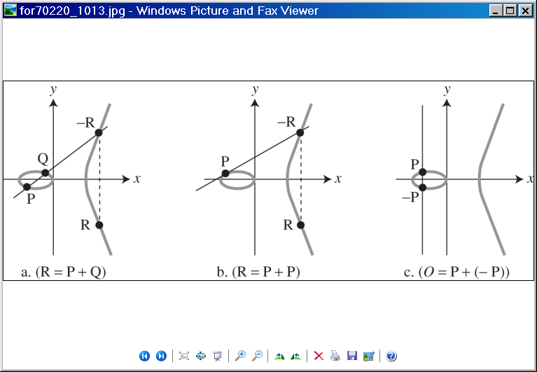
Elliptic points addition P+Q (geometric)

Slide 7

Elliptic points addition P+P (geometric)

Slide 8

Elliptic points addition P-P (geometric)
“complete” the curve by adding point O=-O to infinity
P+O=P
O is (additive) zero for the group of EC points
Now clear why the “inversion” ☺

Slide 9
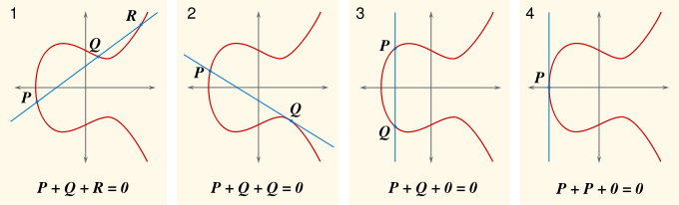
General rule
If three points of an elliptic curve lay on a same line, their sum is 0

Slide 10
Algebraic expressions
Can be derived from geometric interpretation

Slide 11
P≠Q sketch
-R
Q
P
R

Slide 12
P=Q sketch
-R
P
R

Slide 13
Elliptic curve group
(over Zp)

Slide 14
EC over modular integers
Geometric interpretation
Over real numbers
Our applications
Over modular integers
Define “curve” as
E_{p}(x,y) such that
x,y integers in Zp
y² mod p = x³ + a x + b mod p
Finite field → finite # of points

Slide 15
Example: x³+x+1 mod 5
All points:
pairs (i,j), i in [0,4], j in [0,4] s.t. j²=i³+i+1 mod 5
And O
Result: 9 points
Let P=(0,1)
k P=P+P+…+P generates all the points

Slide 16
example computation
Many online calculators available e.g. https://graui.de/code/elliptic2/

Slide 17
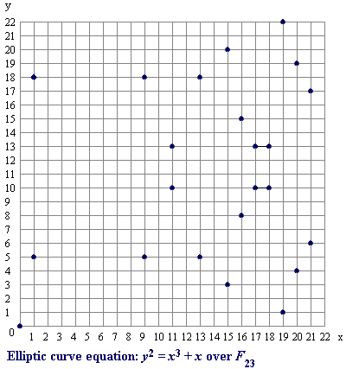
Which points in “larger” group?
No geometric “look&feel” anymore… no problem!

Slide 18
EC group
(E(Z_{p}),+) is a group
Addition closed on set E
Addition is commutative
O is identity wrt addition
Every point P in E has inverse –P wrt addition
Associative property holds
Harder to prove in generality, but holds
Abelian group

Slide 19
EC Group properties for crypto
Easy/hard operation: [k]P
Given P and k, easy to compute [k]P
Given P and [k]P, hard to compute k
P = elliptic curve point on group
k = integer mod group order
“Equivalent” to Dlog problem on Zp
If we had used multiplicative notation: k → P^{k}
CRUCIAL: DEPEND ON THE CHOSEN CURVE!!!
Use curves recommended by standards!!!!
Curves not only in Zp, but also in GF(2^{m}) – Binary curves: convenient!
Different EC curves satisfy different assumptions!
We’ll see (and exploit!) later on: e.g. CDH hard but DDH easy

Slide 20
Multiplication (exponentiation)
Group order 160 bits → q=2¹⁶⁰
Major cost: multiplication
analogous to exp
Uses very large factors k (160 bits)
Efficiency: approx 1.5 Log₂ q
i.e. linear with the number of bits
Basic algorithm: double and sum
(analogous to square & multiply)

Slide 21
Example
Goal: compute [1437]P
Express in bits
1437₁₀=10110011101₂
Initialize first line
Differs if 0 or 1
Start from 2° lsb to msb
For every bit
Double;
If 1: add to result
Complexity:
O(nbit) x2
O(nbit/2) additions
No algorithm such as this for the opposite problem!! That’s why it is hard!

Slide 22
Elliptic curve crypto
(examples)

Slide 23
EC crypto
Invented in 1985
Neal Koblitz
Victor Miller
(independently)
Security: based on hardness of:
Given P and [k]P, hard to compute k
Elliptic Curve Discrete Log Problem – ECDLP
Much shorter keys than RSA/DLP
And better scaling!
Symm key equiv modulus size
80 bits 1024 bits
128 bits 3072 bits
256 bits 15360 bits
Elliptic Curve
163 bits
283 bits
571 bits

Slide 24
ECDH/ECDSA
Topmost used, since included in US National Security Agency – suite B ciphers
Suite B: NIST-approved, promoted in 2005, adopted in TLS, IPsec, S/MIME, etc
Algorithms:
Encryption: AES 128/256
Key Exchange: ECDH
256 and 384 bit prime curves
Digital Signature: Elliptic Curve Digital Signature Algorithm (ECDSA)
256 and 384-bit prime moduli
Hashing: SHA-256 and SHA-384

Slide 25
ECDH
Exactly as DH
Just use as group an EC group!
(prime p of Zp, curve param a and b, group order q)
C
x, [x]G
secret = [xy]G
G, [x]G
S
y, [y]G
secret = [yx]G
[y]G

Slide 26
ECDSA
Elliptic Curve Digital Signature Algorithm
EC version of DSA
Invented by Vanstone
Proposed by NIST in august 1991
adopted by NSA Suite B
Variant of ElGamal
Dlog based
Famous also for other reasons ☺
Broken in Playstation 3, 2010
Not because ECDSA is vulnerable…
Because of incorrect usage, see later

Slide 27
Let’s first remember DSA (simplified)
Multiplicative group
Z*(p), p>2 prime
Large prime q in group order
Usually p = 2q+1 (safe prime)
Generator
g s.t. g^{x} mod p spans all group elements
Private/Public keys
d, y = g^{d} mod p

Slide 28
Let’s first remember DSA (simplified)
Signature for message m
Random k in (1,q)
Compute r = (g^{k} mod p) mod q
Compute s = k⁻¹ (H(m)+ d r) mod q
Signature: (r,s)
Verification
Compute u₁ = s⁻¹ H(m) mod q
Compute u₂ = s⁻¹ r mod q
Verify ((g^{u1} y^{u2}) mod p) mod q = r

Slide 29
ECDSA: setup
Group
Order
(prime, large)
Selected Elliptic
curve over Z_{p}
Group
Generator
Public param
& pubkey:
Public Key
Private key:
d = random integer in [1,n-1]
Q = dP

Slide 30
ECDSA: signature generation
k in [1,n-1]: random integer
ESSENTIAL: MUST BE
unique per each signature
unpredictable
Compute kP=(x₁,y₁) EC point
x₁ is integer, then
Compute r = x₁ mod n
Compute k⁻¹ mod n
Hash function H(.) e.g. SHA
Signature:
(r,s)
s=k⁻¹(H(m) + d r)

Slide 31
ECDSA: verification
From message m
compute H(m)
From s
compute w=s⁻¹ mod n
Compute integers:
u₁ = H[m] w mod n
u₂ = r w
Compute elliptic point
u₁ P + u₂ Q = (x₀,y₀)
Compute
v = x₀ mod n
Verification:
v=r
Note: k never disclosed!

Slide 32
What if k predicted??
Private key would be disclosed!

Slide 33
What if k repeated??
Private key would be disclosed!
This is what happened with Sony’s Playstation 3

